Slide 1
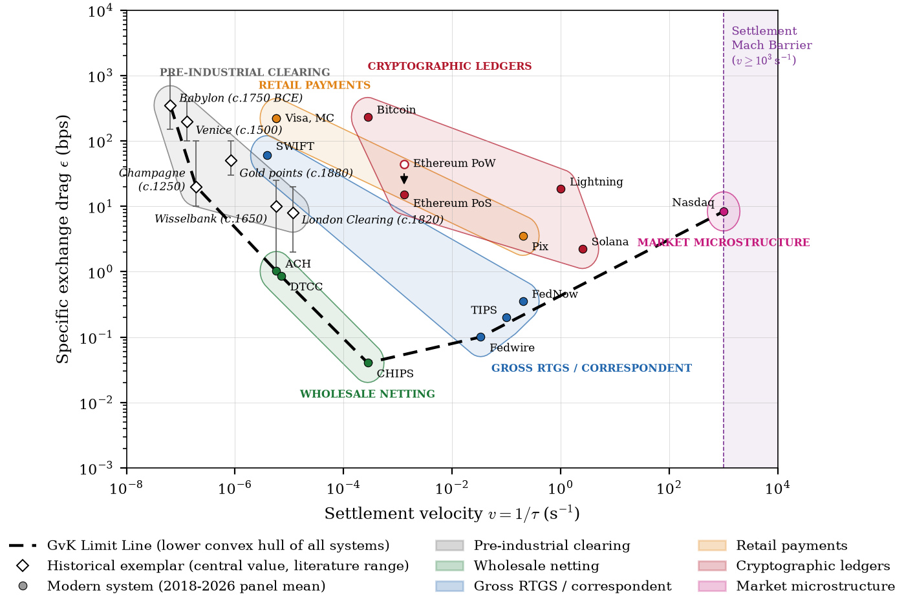
EXECUTIVE BRIEFING
Settlement speed has a price, and the policy rate sets much of it
A Gabrielli–von Kármán frontier for financial settlement systems, from Babylonian storehouses to proof-of-stake
Rolf Bastiaanssen
Director, Bax Innovation, Barcelona
The GvK Limit Line: specific exchange drag against settlement velocity, 21 systems
Modern-system figures come from a calibrated structural simulation (15 systems, 106 months, N = 1,466) benchmarked to public disclosures.
Notes:
Frame: Gabrielli and von Kármán asked in 1950 what price speed carries for vehicles. This briefing asks the same of settlement. Disclose upfront that modern values are a calibrated simulation; the empirical study needs operator data (last slide).

Slide 2
Every settlement system since 1750 BCE sits on or above one cost limit line
Specific exchange drag ε adds four costs per unit of value settled: fees, risk reserves, energy and the funding cost of locked collateral. Plotted against settlement velocity, all 21 systems lie on or above a U-shaped lower boundary.
Wholesale netting forms the floor. CHIPS, ACH and DTCC define the line's lowest stretch.
Retail and proof-of-work sit far above it. Cards and Bitcoin carry one to two orders of magnitude more drag.
Beyond 10³ settlements per second, extra speed mainly redistributes rents.
Figure 1 of the working paper. Historical exemplars show literature ranges.
Source: Bastiaanssen (2026), What Price Settlement Speed? Working paper. Modern-system values are a calibrated structural simulation, not observed data.
2
Notes:
Read the chart left to right: slow pre-industrial clearing, the netting floor, gross RTGS rising towards the Mach barrier. The line is the lower convex hull of all systems, recomputed whenever inputs change.

Slide 3
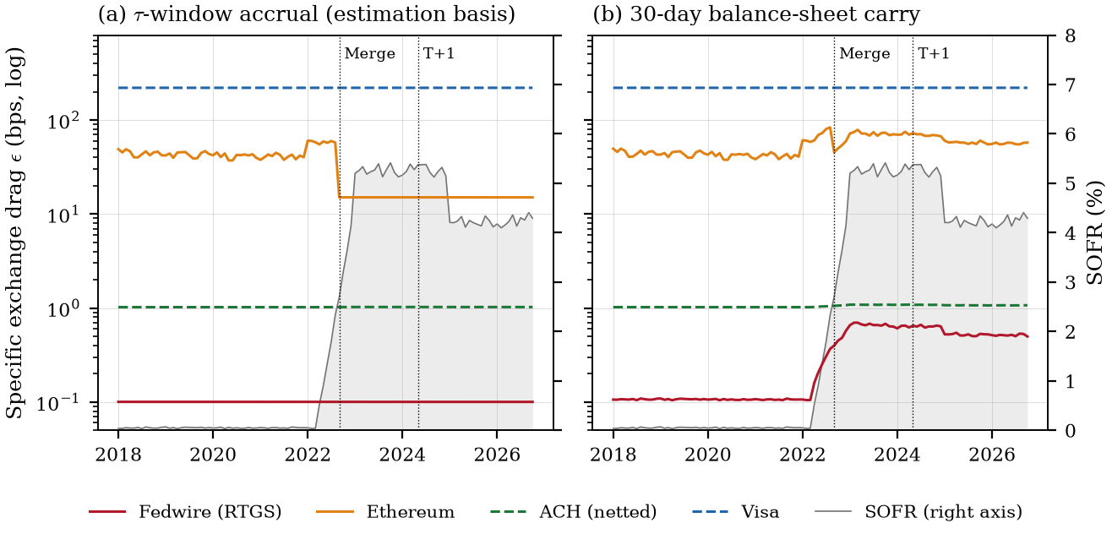
When SOFR rose from 0.03% to 5.41%, only capital-bound systems repriced
0.364
capital-bound rate slope in the simulation's response surface
Proposition 1: the rate elasticity of drag equals the collateral share of cost. Fedwire reprices with SOFR on the carry basis. Visa and netted ACH barely move.
Figure 2: drag by month, 2018 to 2026, on the transaction-window (a) and balance-sheet carry (b) bases.
Source: Bastiaanssen (2026), What Price Settlement Speed? Working paper. Modern-system values are a calibrated structural simulation, not observed data.
3
Notes:
The 0.364 is a point value from the response surface that summarises the calibrated simulation (paper Appendix B); no p-value is quoted because the panel is synthetic. The evidence is Proposition 1, an identity: rate sensitivity equals the collateral share. Capital-bound designs, including prefunded instant payments, should be stress-tested across rate regimes, not only at the rate prevailing during a pilot.

Slide 4
Netting is the floor: netted systems carry no premium above the limit line
0.00
Policy reading
wrapper premium of CHIPS, ACH and DTCC above the GvK limit line (Table 2)
The netting floor is the most persistent regularity in four thousand years of settlement, from Babylonian storehouses to CHIPS.
610×
Atomic delivery-versus-payment on a shared ledger removes the netting window by design. Proposals should show how liquidity savings are preserved, for example through liquidity-saving queues or programmable netting.
gross-to-netted drag ratio at equal speed in the calibration's response surface
The 610× ratio returns the calibration's netting assumption by construction: it shows scale, not causal proof.
Source: Bastiaanssen (2026), What Price Settlement Speed? Working paper. Modern-system values are a calibrated structural simulation, not observed data.
4
Notes:
In the class view of the paper (Proposition 3, Table 2), the wholesale netting class is the limit line over its span: its wrapper premium is zero. The 610× figure comes from the appendix response surface of the simulation and is illustrative, because the calibration builds netting in.

Slide 5
Faster settlement can cut per-trade collateral cost and still raise standing liquidity needs
Proposition 2: if required collateral rises with speed at an elasticity η between 0 and 1, the cost charged per settlement window falls while the balance-sheet carry rises. Both effects are real; they sit in different accounts.
T+2 to T+1, May 2024
T+1 to T+0, scenario
Clearing-fund collateral ×1.35, η = 0.433
Collateral ×10 as τ falls from 1 day to 10 s, η = 0.254
×0.675
window cost per settlement, about one third lower
×0.0012
window cost per settlement
+35%
monthly carry cost of locked collateral
×10
monthly carry cost of locked collateral
Source: Bastiaanssen (2026), What Price Settlement Speed? Working paper. Modern-system values are a calibrated structural simulation, not observed data.
5
Notes:
This is why the T+0 debate splits: operators quoting the window basis see savings, treasurers on the carry basis see a tenfold liquidity bill. Ask applicants to report both and the implied η.

Slide 6
Card networks carry a 216-fold wrapper premium above the limit line at their speed
216×
220.1 bps
retail-class premium at card speed, π = 5.38 (Table 2); Pix, with a thinner bundle, ×16
Bundled credit float, fraud guarantees and dispute rights can only add to drag, so the limit line is an upper bound on pure settlement cost (Proposition 3). Part of interchange is a transfer, not a resource cost.
1.0 bps
Visa mean drag
Limit line at Visa's speed
Source: Bastiaanssen (2026), What Price Settlement Speed? Working paper. Modern-system values are a calibrated structural simulation, not observed data.
6
Notes:
Proposition 3 splits each system's distance from the limit line into a within-class distance and a wrapper premium. For cards the premium is about 216 times the frontier drag at the same speed; Pix, the retail system with the thinnest bundle, carries about 16 times. The premium mixes the price of bundled services with any core-technology gap; it is an upper bound on the wrapper's price when card core technology is no better than the frontier.

Slide 7
The Merge moved Ethereum's security cost from the energy market to the money market
99.94%
Ethereum drag at the 2023 rate peak, bps
fall in Ethereum's energy cost at the Merge, September 2022
79 bps
44.8 to 15.0 bps
mean drag before and after, transaction-window basis
15 bps
Disclosures under MiCA capture energy. A complete assessment also books the capital locked in staking and its sensitivity to the policy rate.
Window basis
Carry basis
Source: Bastiaanssen (2026), What Price Settlement Speed? Working paper. Modern-system values are a calibrated structural simulation, not observed data.
7
Notes:
Proof-of-stake did not remove the cost of security: on the carry basis, the locked stake is charged its full monthly opportunity cost, so drag peaks with the policy rate.

Slide 8
Bitcoin's drag of 128 to 362 bps is 94% energy, far above the limit line
128 to 362 bps
monthly drag range, 2018 to 2026, against 15.0 bps for Ethereum after the Merge
Proof-of-work buys settlement finality with electricity. By the same identity as Proposition 1, its drag moves almost one for one with the power price and barely with the policy rate.
Source: Bastiaanssen (2026), What Price Settlement Speed? Working paper. Modern-system values are a calibrated structural simulation, not observed data.
8
Notes:
Mean energy share across panel months. Contrast with slide 7: the same security function, booked in a different cost component.

Slide 9
Five tests separate a genuine settlement saving from a relabelled cost before a pilot is authorised
Dimension | Typical failure in a proposal | Required GvK test
Liquidity and float | Collateral saving claimed on transaction float alone | Collateral cost on window and 30-day carry basis, with the implied η
Netting preservation | Atomic DvP removes the netting window and raises gross liquidity needs | Documented liquidity-saving queues or programmable batch netting, and their effect on locked capital
Security migration | Proof-of-stake presented as near-zero cost because energy use is small | Opportunity cost of staked capital booked next to energy and hardware
Monetary robustness | Liquidity model tested only at the pilot rate, often near zero | Drag recomputed at 0% and 5.5%; rate elasticity equals the collateral share
Latency value | Hardware cost justified by sub-millisecond finality | Above 10³ per second, proof that drag falls, not only latency
Source: Bastiaanssen (2026), Section 6, Table 3; CPMI–IOSCO PFMI (2012). Interactive version: GvK Sandbox Scorecard.
9
Notes:
Use as a due-diligence scorecard for EU DLT Pilot Regime applicants and national sandboxes. Each row names the claim that most often fails in a proposal and the test, stated in the paper's quantities, that the authority can require before authorising a pilot. The interactive scorecard computes the implied eta, both collateral bases, the rate stress and the Mach Barrier test from the applicant's current and proposed design; the default figures are the paper's calibrated T+0 scenario, not observed data.

Slide 10
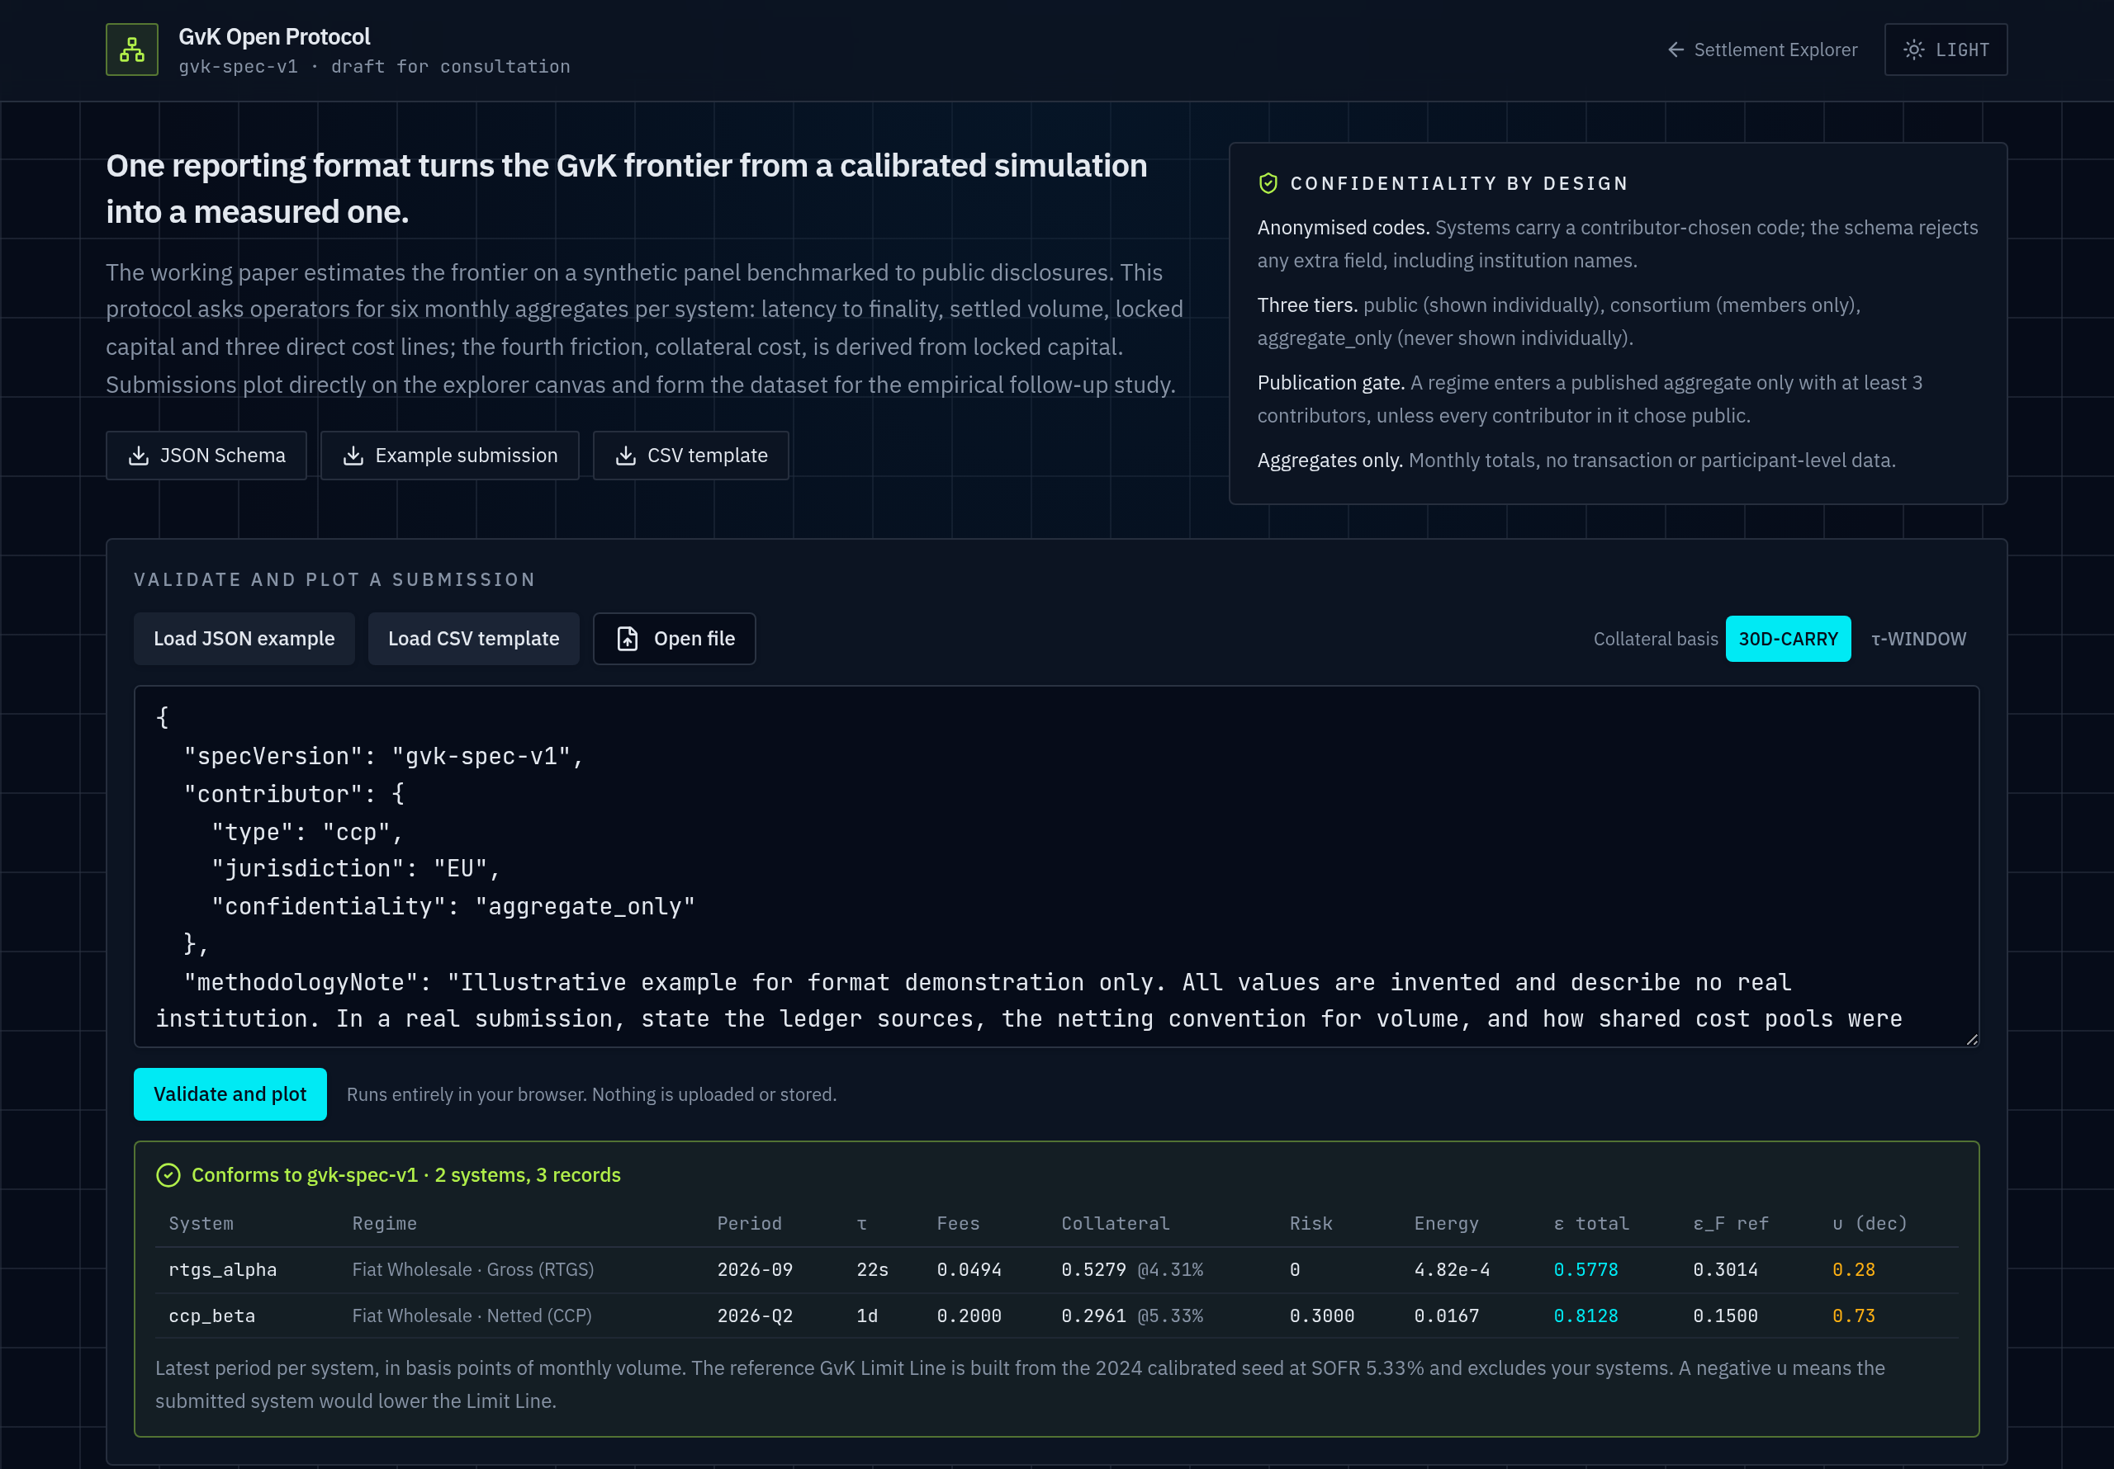
Shared operator data turns this simulation into evidence
Six monthly figures per system
Speed to finality, value settled, locked capital, fees, risk and energy cost.
Anonymised by design
Contributor-chosen codes; the format rejects institution names.
Publication gate
A regime enters published totals only with at least 3 contributors.
Checked in the browser
Operators validate files locally. Nothing is uploaded.
Proposed next step: a consortium of operators and authorities contributing 2018 to 2026 data. Details at settlementfrontier.org/protocol
Protocol page with the example submission validated
GvK Open Protocol, specification gvk-spec-v1, draft for consultation. Validator and templates in the GvK Settlement Explorer.
10
Notes:
Close on the ask. The empirical paper replaces the calibrated panel with contributed data under the same schema, so every chart in this deck can be redrawn on observed figures.

